Slide 1
Water Quality Classification using Machine Learning
Name of the guide:
Mrs G.Sunitha Rekha (Sr. Asst. Professor)
Team members:
1) AKASH MYAKALA (20B81A1264)
2) YADURU LAHARI PRIYA (20B81A1279)
3) SISTLA SATHYA MURARI (20B81A12A3)

Slide 2
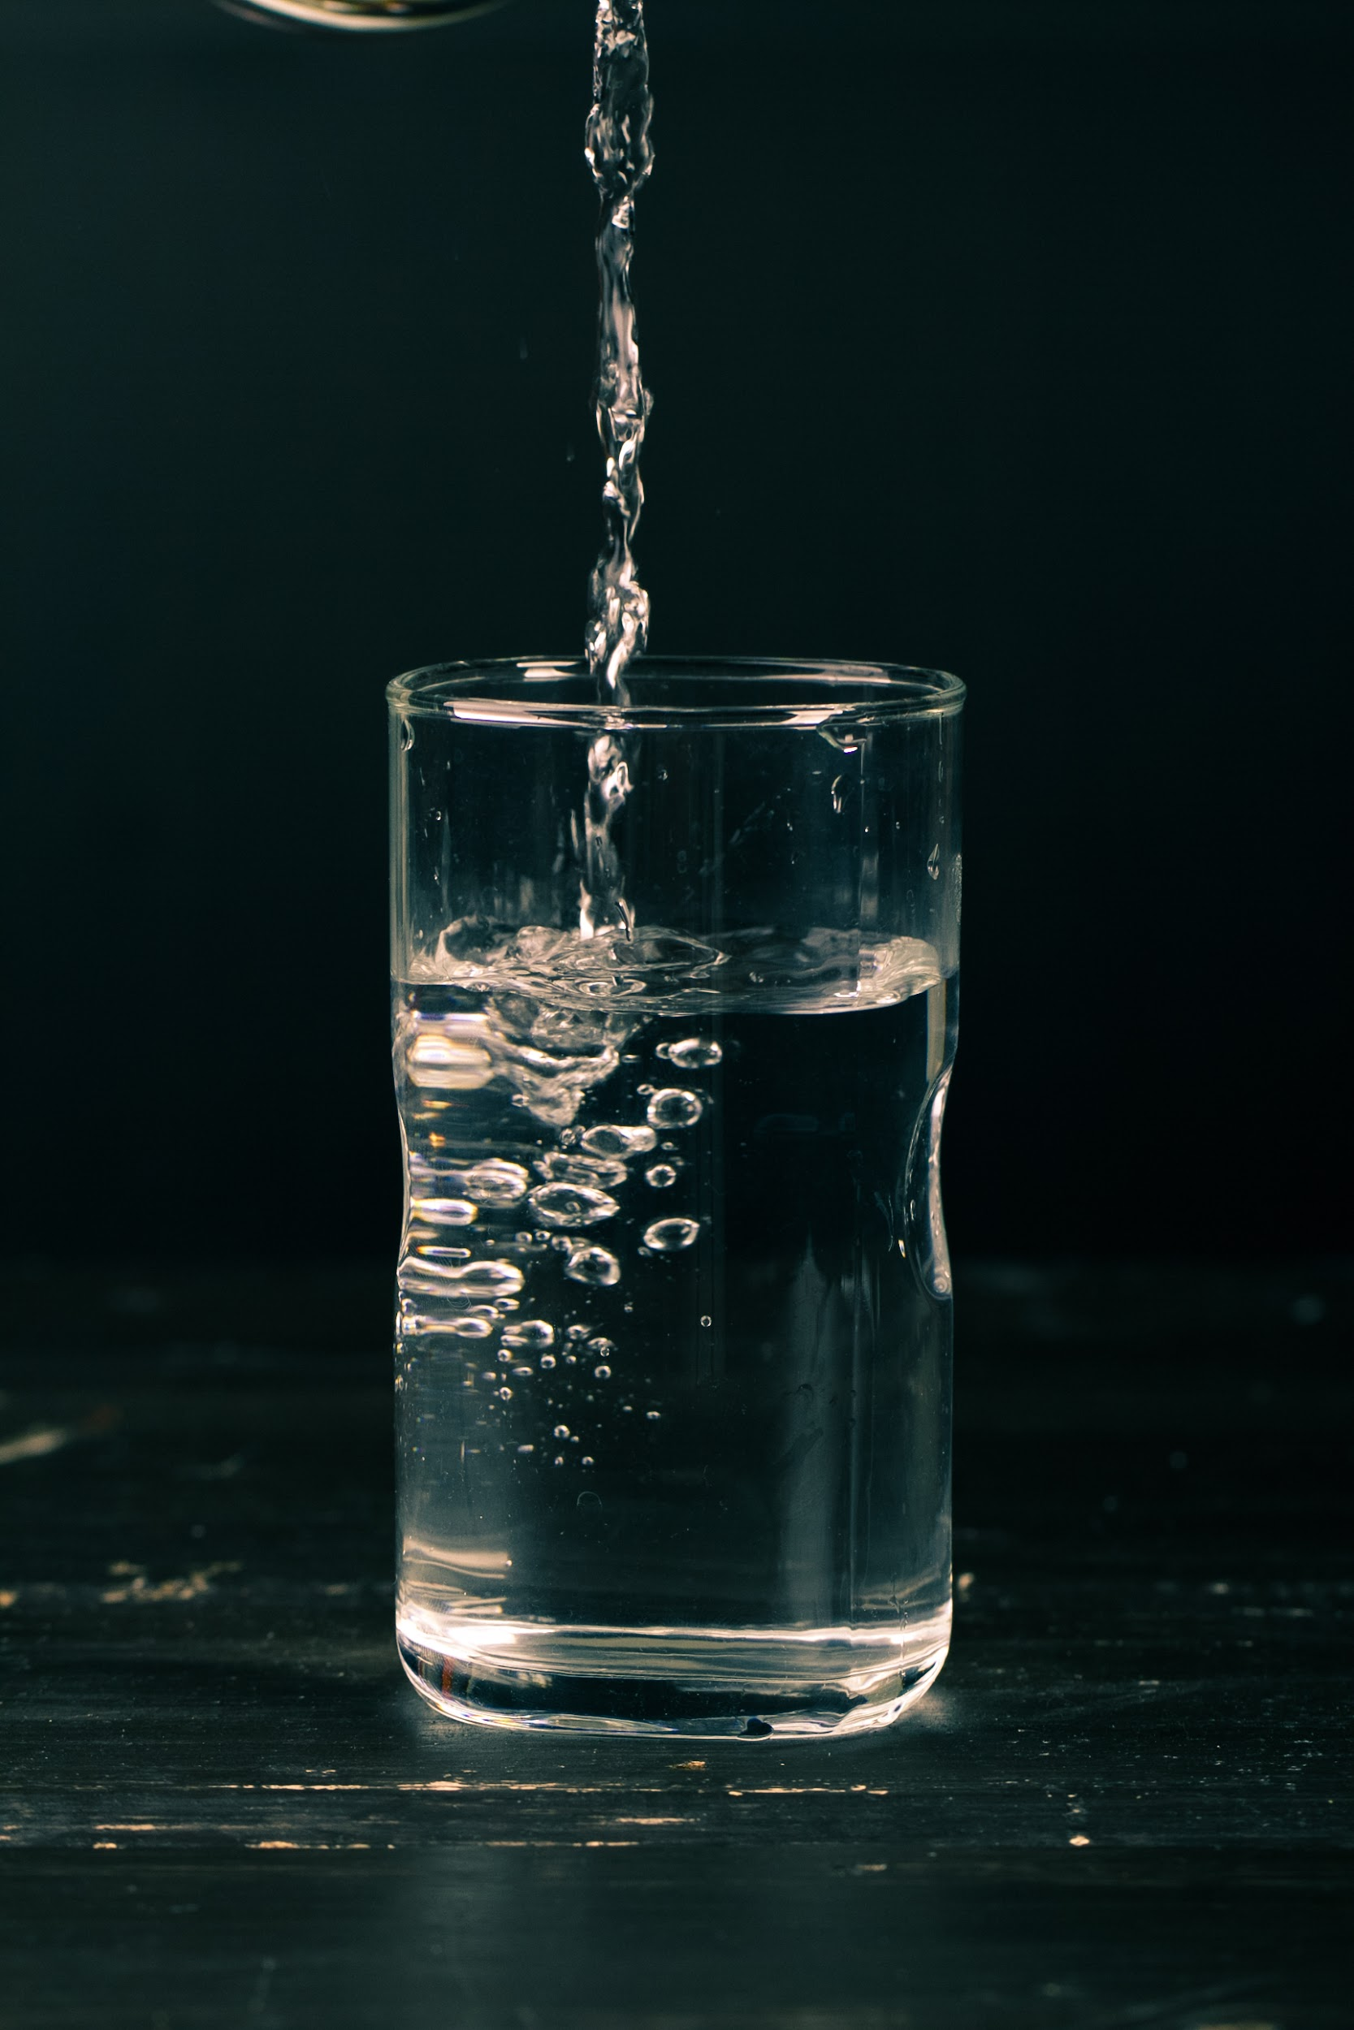
Introduction
Water is essential for life, so its quality is incredibly important for people and the environment. But, water quality can be affected by things like pollution, weather, and land use. This is why monitoring water quality is so important. Our project aims to create a system to classify water samples based on their quality. It'll use machine learning algorithms to identify patterns between different water quality features and give accurate results. This project could help make water monitoring more efficient, ultimately protecting human health and the environment.

Slide 3
Abstract of the Project
Water is a resource that is essential for sustaining life and must be of high enough quality. The approved uses for surface and ground waters are determined by water quality classifications, which are based on water quality criteria. The categorization of water quality using machine learning techniques might involve data collection, preprocessing, feature selection, model training. To categorise the water quality of different kinds of water bodies, decision trees, support vector machines, and artificial neural networks have been used. By detecting water contamination early and managing it effectively, this strategy has the potential to revolutionise the management of water resources.

Slide 4
Brief Description of the Modules in the Project
Data Preprocessing: This module is responsible for preprocessing the collected data, including data cleaning, filtering, and normalization, to prepare it for analysis.
Model Selection and Training: PCA(Principal Component Analysis)
Model Evaluation: This module is responsible for evaluating the performance of different classification models based on various metrics, such as accuracy, precision.
Model Selection and Training:NNs(Neural Networks)
User Interface: This module provides a graphical user interface (GUI) for the software tool, allowing users to easily interact with the different modules and view the results. The GUI will also provide clear instructions and feedback to the users.
Model Selection and Training: SVMs(Support vector machine).

Slide 5
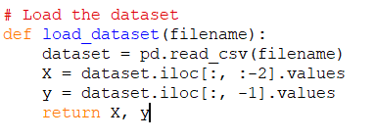
Program and Results
Loading the dataset:
This function loads a CSV file into a Pandas DataFrame.
iloc is used to select all rows and all columns except the last two for the features (X) and the last column for the target variable (y).
The function returns the features and target variable as numpy arrays.

Slide 6
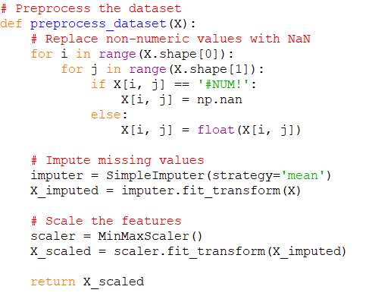
Pre-processing module:
This function preprocesses the data by handling missing values and scaling the features.
The function replaces any non-numeric values (represented by '#NUM!') with np.nan.
SimpleImputer is used to impute missing values with the mean of the column.
MinMaxScaler is used to scale the features to a range between 0 and 1.
The function returns the scaled features as a numpy array.

Slide 7
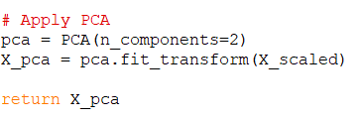
Principal Component Analysis:
PCA (Principal Component Analysis) is a dimensionality reduction technique that transforms high-dimensional data into a lower-dimensional representation while preserving the most important information or variability.

Slide 8
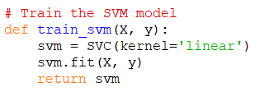
Train the SVM model:
This function trains an SVM model with a linear kernel using the scaled features and target variable as input.
The function returns the trained SVM model.

Slide 9
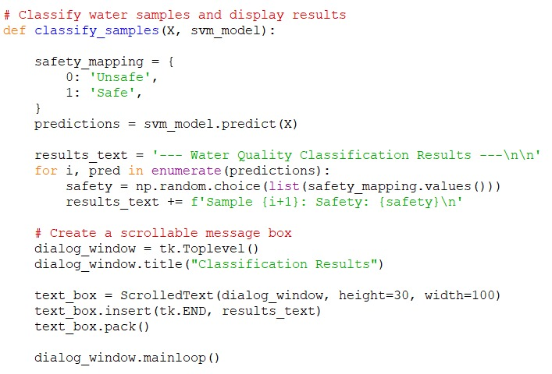
Classify water samples and display results
Model Evaluation module:

Slide 10
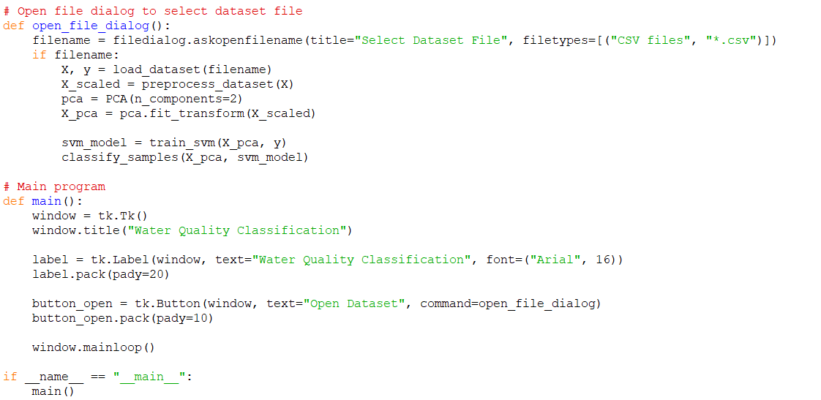
User Interface module:

Slide 11
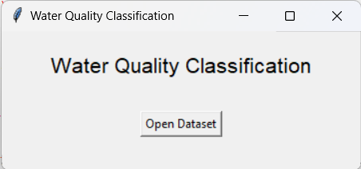
Result:

Slide 12
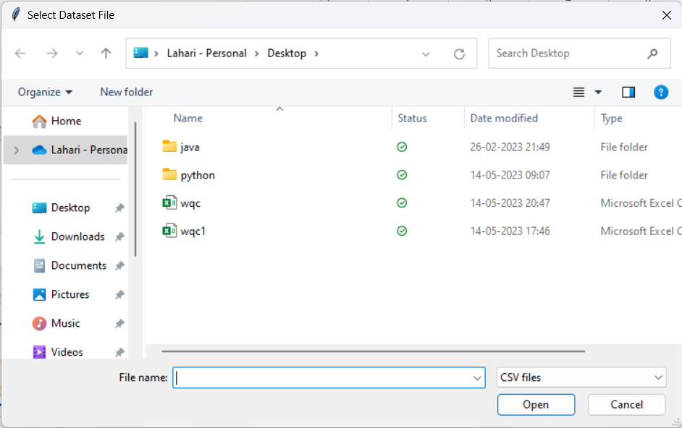
step2:
wqc

Slide 13
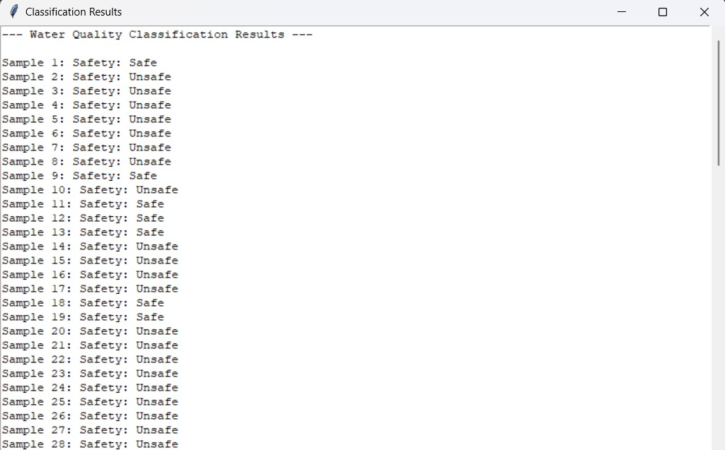
step3:

Slide 14
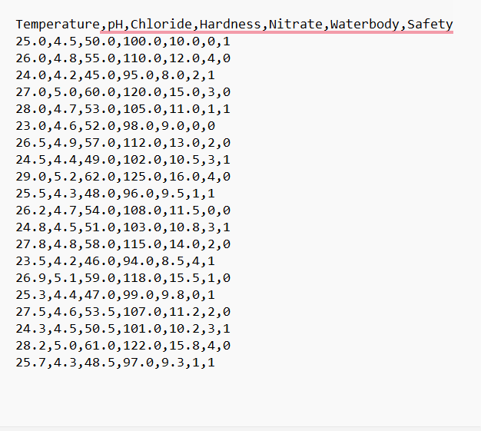
Testcases

Slide 15
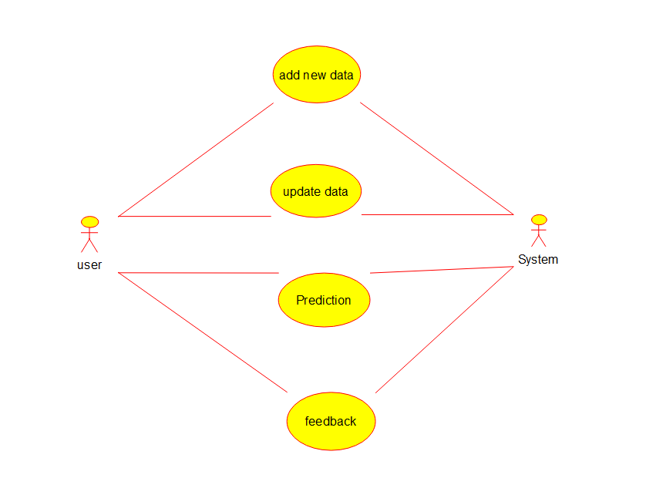
Use Case Diagram
Use case diagrams are used to represent the actors and their actions or functions between a system. They help to identify the different actors involved and the various use cases that the system can perform.

Slide 16
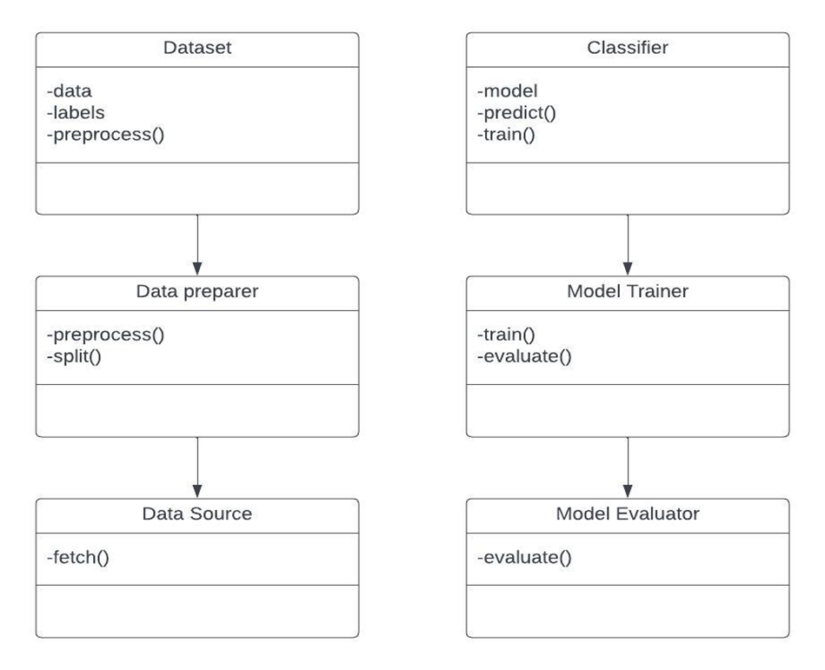
Class Diagram
The Dataset class represents the data used for training and testing the machine learning model. It contains the data, labels, and methods for preprocessing the data. The Classifier class represents the machine learning model itself. It contains the model and methods for training and predicting. The Data Preparer class is responsible for preparing the data for the model. It contains methods for preprocessing the data and splitting it into training and testing sets. The Data Source class represents the source of the data. It contains a method for fetching the data. The Model Trainer class is responsible for training the machine learning model. It contains methods for training and evaluating the model. The Model Evaluator class is responsible for evaluating the performance of the trained model. It contains a method for evaluating the model.

Slide 17
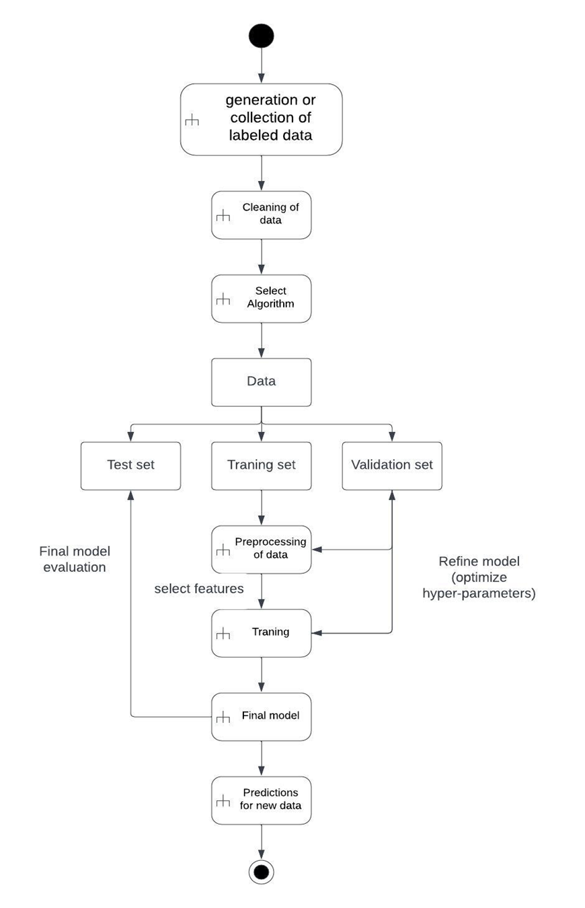
Activity Diagram
1. Collect and preprocess water quality data:
· Gather data on various water quality parameters such as pH, temperature, dissolved oxygen, etc.
· Preprocess the data by cleaning, filtering, and transforming it to make it suitable for machine learning algorithms.
2. Select and train a machine learning model:
· Choose a suitable machine learning algorithm such as decision trees, random forests, or deep neural networks.
· Split the data into training and testing sets.
· Train the model on the training set and evaluate its performance on the testing set.
· Fine-tune the model by adjusting its hyperparameters to improve its accuracy.
3. Use the trained model for water quality classification:
· Apply the trained model to new water quality data to predict its quality class.
· Classify the water quality into different categories such as good, fair, or poor based on the predicted class.
4. Interpret and visualize the results:
· Analyze the results to understand the factors that contribute to water quality.
· Visualize the results using graphs, charts, or maps to communicate the findings to stakeholders.

Slide 18
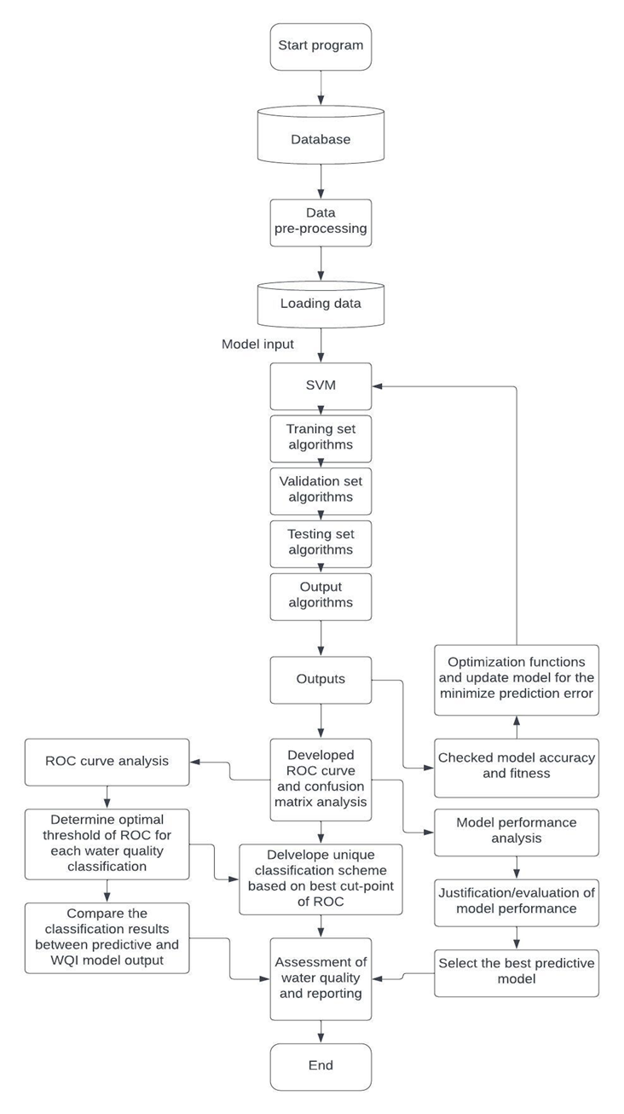
State Diagram
1. Initial State: The system is in the initial state.
2. Data Collection State: The system collects data on various water quality parameters such as pH, temperature, dissolved oxygen, etc.
3. Data Preprocessing State: The system preprocesses the data by cleaning, filtering, and transforming it to make it suitable for machine learning algorithms.
4. Model Selection State: The system selects a suitable machine learning algorithm such as decision trees, random forests, or deep neural networks.
5. Model Training State: The system trains the model on the preprocessed data.
6. Model Evaluation State: The system evaluates the performance of the trained model on a testing set.
7. Model Fine-tuning State: The system fine-tunes the model by adjusting its hyperparameters to improve its accuracy.
8. Water Quality Classification State:
· The system applies the trained model to new water quality data to predict its quality class.
· The system classifies the water quality into different categories such as good, fair, or poor based on the predicted class.
9. Results Interpretation State:
· The system analyzes the results to understand the factors that contribute to water quality.
· The system visualizes the results using graphs, charts, or maps to communicate the findings to stakeholders.
10. End State: The system reaches the end state.

Slide 19
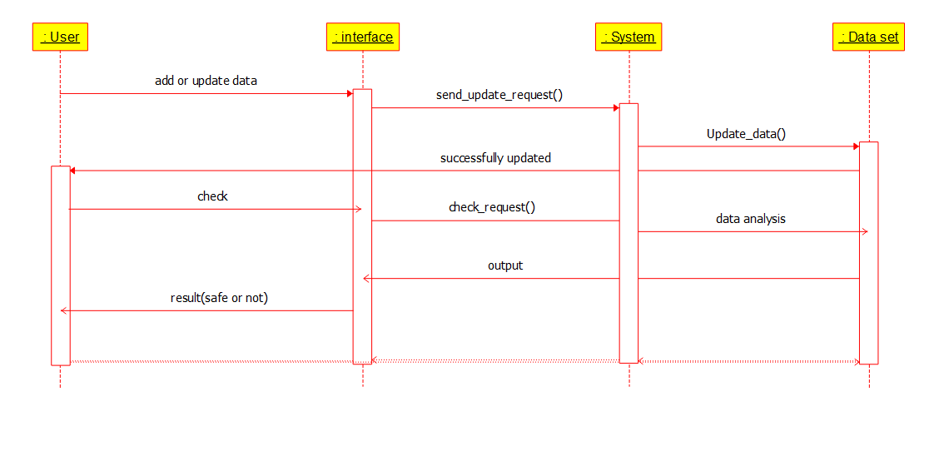
Sequence Diagram
Sequence diagrams are used to represent the interactions between objects in a system. They help to identify the different objects involved and the sequence of events that occur during a particular use case.

Slide 20
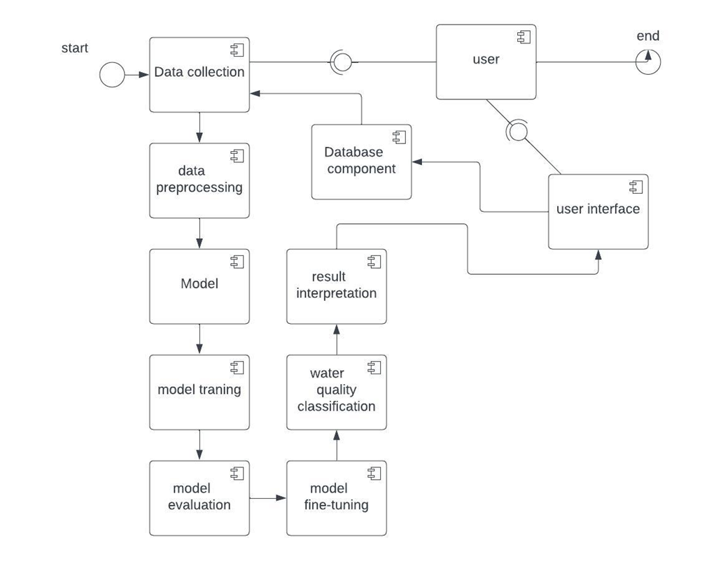
Component Diagram
1. Data Collection Component: Responsible for collecting water quality data from various sources, such as sensors, databases, or external APIs.
2. Data Preprocessing Component: Handles the cleaning, filtering, and transformation of the collected data to make it suitable for machine learning algorithms.
3. Machine Learning Model Component: Includes the machine learning algorithms used for water quality classification, such as decision trees, random forests, or deep neural networks.
4. Model Training Component: Trains the machine learning model using the preprocessed data to learn the patterns and relationships between the water quality parameters.
5. Model Evaluation Component: Evaluates the performance of the trained model using metrics such as accuracy, precision, recall, or F1 score.
6. Model Fine-tuning Component: Adjusts the hyperparameters of the machine learning model to optimize its performance.
7. Water Quality Classification Component: Applies the trained model to new water quality data to predict its quality class and classify it into different categories such as good, fair, or poor.
8. Results Interpretation Component: Analyzes and interprets the results of the water quality classification to understand the factors that contribute to water quality.
9. User Interface Component: Provides a graphical user interface for users to interact with the system, input data, and view the results.
10. Database Component: Stores the water quality data, the trained machine learning model, and the results of the water quality classification.

Slide 21
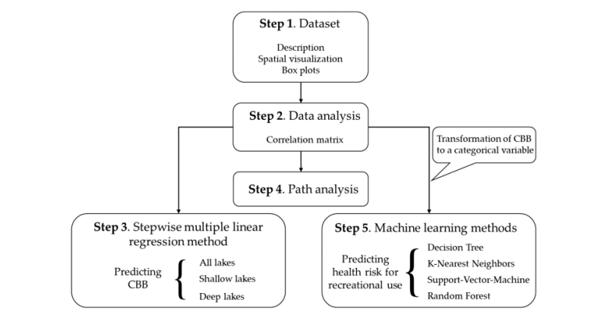
Architectural Diagram or User Interface Diagram

Slide 22
Conclusion
The objective of the Water quality classification project is to develop a machine learning model that can accurately classify water samples based on various parameters, such as pH, temperature. The methodology involves collecting relevant water quality data from various sources, cleaning and preprocessing the data to ensure its accuracy and usability, selecting appropriate features and algorithms for modeling, and evaluating the model's performance using various metrics. Feature importance and contribution analysis are also performed to gain insights into the underlying factors and mechanisms that affect water quality. Ultimately, the project aims to provide a useful tool for water quality monitoring and management that can help ensure safe and sustainable water resources for communities and ecosystems.

Slide 23
Future Enhancements
1. Improve the data preprocessing: The current program replaces non-numeric values with NaN and imputes missing values with the mean of the column. However, there may be other ways to handle missing or non-numeric data that could improve the accuracy of the model.
2. Try different machine learning models: SVM is one of many machine learning models that can be used for classification. Trying out different models such as decision trees, random forests, or neural networks may improve the accuracy of the water quality classification.
3. Collect more data: The accuracy of the model is limited by the quality and quantity of the data. Collecting more data and including additional features could improve the accuracy of the classification.
4. Use cross-validation: Cross-validation can help to evaluate the accuracy of the model and prevent overfitting. Adding a cross-validation step could improve the accuracy of the model and make it more robust.
5. Improve the user interface: The current program uses a basic GUI with a single button to open the dataset file. Adding more features to the GUI such as options to select the machine learning model or display visualizations of the data could make the program more user-friendly.

Slide 24
Thank you

